Slide 1
Project Review
Purpose:
Review current state of software/system infrastructure
Present vision for future infrastructure
Suggest a migration plan

Slide 2
Where We Are Now
Web site up and running
Desktop application up and running (more or less)
Code is
  stable but needs further hard testing
  Should be refactored and reorganized

Slide 3
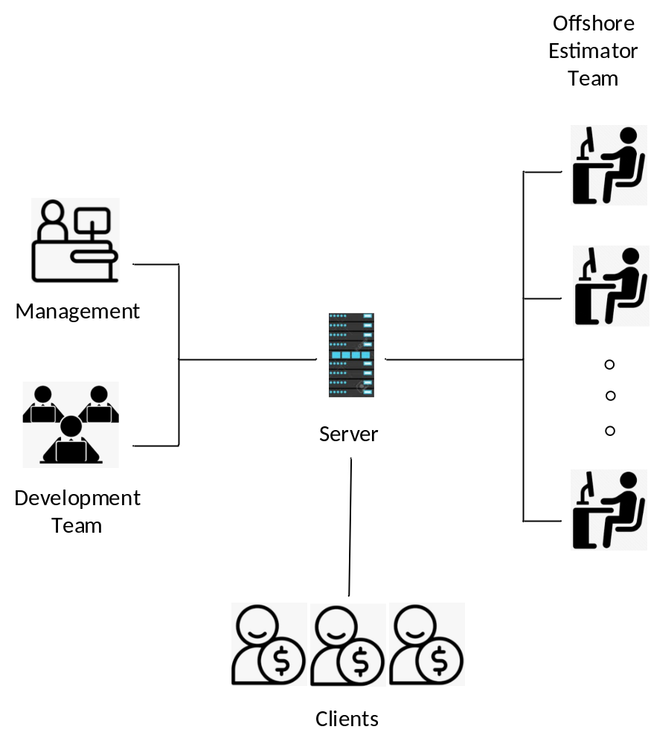
Where We Should Be
Server with access for:
Management
  Access to projects estimator work
  Access to client activities
Estimator team member
  Log in / log out
  Projects
Clients
  Log in to own account
  Project requests
  Project reports

Slide 4
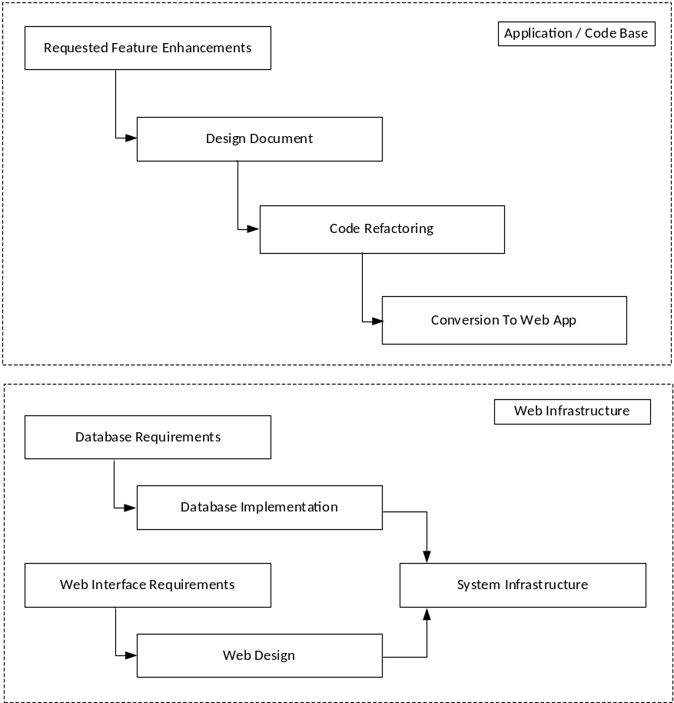

Slide 5
What is needed
Convert from desktop to web based application. According to Bernie, there are ways to do this that can use much of the current code base
Most of the current code base can be cleaned up and reused
Big question: what do we need to support graphics
Must use GPU

